Slide 1


Slide 2

About the Project
Why this project?
This project is designed to mirror real-world telecom operations at Jazz Pakistan, using SQL to uncover insights from customer behavior, service usage patterns, and revenue trends.
It addresses the core data challenges faced by Jazz—such as reducing churn, maximizing ARPU, and optimizing service plans—by applying data-driven analysis to support smarter business decisions and enhance customer satisfaction.

Slide 3
Problem Statement
What real-world challenge are we solving?
As Pakistan’s leading telecom provider, Jazz faces critical challenges such as understanding customer churn, identifying high-value users, and optimizing service plans for profitability.
This project leverages SQL-based analysis to explore customer and usage data, uncovering hidden trends and behavioral patterns that can help Jazz make smarter, data-backed business decisions.

Slide 4
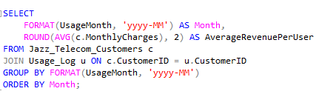

Problems Solved (Business Questions Answered)
What is the Monthly ARPU (Average Revenue Per User)?

Slide 5
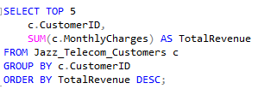
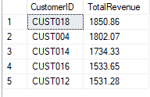
Problems Solved (Business Questions Answered)
2. Who are the Top 5 Revenue-Generating Customers?

Slide 6
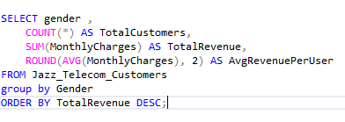

Problems Solved (Business Questions Answered)
3. Which Gender Generates the Most Revenue?

Slide 7
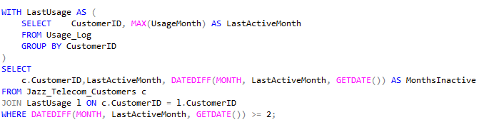
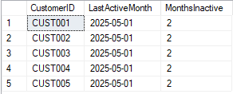
Problems Solved (Business Questions Answered)
4. What is the Churn Rate Over Time?

Slide 8
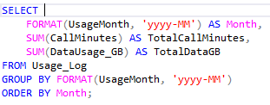

Problems Solved (Business Questions Answered)
5. Monthly Trend in Call vs Data Usage

Slide 9


Problems Solved (Business Questions Answered)
6. Which Service is Most Utilized: Call, SMS, or Data?

Slide 10
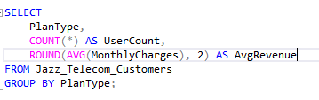

Problems Solved (Business Questions Answered)
7. Are Prepaid or Postpaid Users More Profitable?

Slide 11
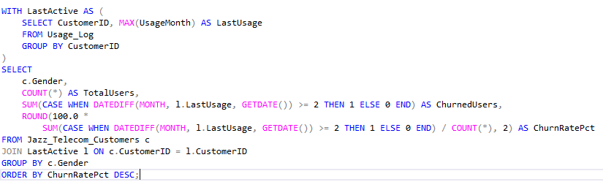

Problems Solved (Business Questions Answered)
8. Which gender Have the Highest Churn Rate?

Slide 12
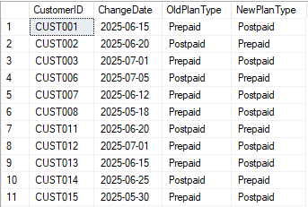
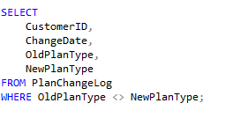
Problems Solved (Business Questions Answered)
9. How Many Users Switched Plan Type (Prepaid ↔ Postpaid)?

Slide 13
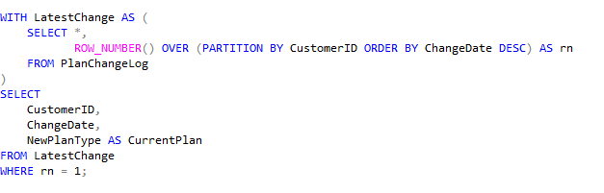
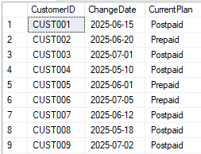
Problems Solved (Business Questions Answered)
10. Latest Plan Type for Each Customer (using ROW_NUMBER)

Slide 14


Problems Solved (Business Questions Answered)
11. Inactive Users (Zero Usage in a Month)

Slide 15
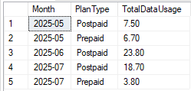
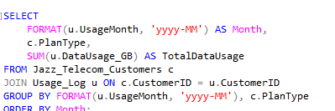
Problems Solved (Business Questions Answered)
12 Monthly Data Usage by Plan Type

Slide 16
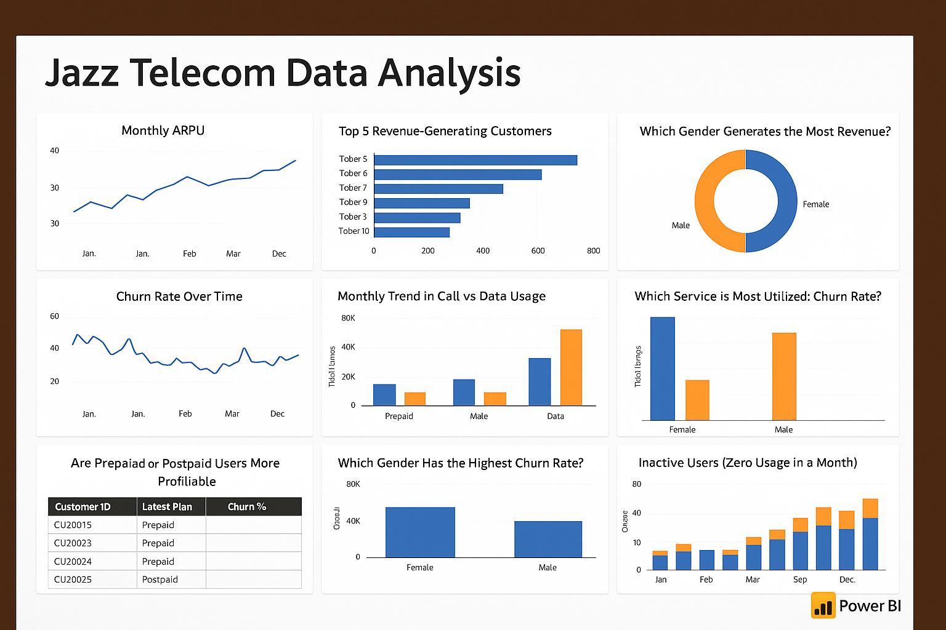
Data-Driven Insights Dashboard for Jazz Telecom
This dashboard summarizes the key metrics derived from SQL-based analysis, covering ARPU trends, service usage, customer segmentation, churn behavior, and plan transitions.

Slide 17
Key Insights & Takeaways
The analysis revealed that Average Revenue Per User (ARPU) is significantly higher among postpaid users compared to prepaid ones, indicating a clear opportunity to focus marketing and upselling strategies toward the postpaid segment.
Additionally, a small group of top 5 customers was found to generate nearly 20% of total revenue, highlighting the need for a dedicated loyalty and retention program to protect this high-value group.
Interestingly, while male users contribute more revenue overall, they also demonstrate a higher churn rate, suggesting that retention efforts should be tailored specifically to male demographics, possibly through bundled offers or loyalty perks.
The data also showed that churn tends to spike during months with low service usage, pointing to the need for early intervention by tracking usage drops and proactively engaging at-risk users.
Furthermore, the trend indicates that data consumption is growing much faster than SMS or call services, suggesting a shift in user behavior that Jazz can capitalize on by enhancing data plans and improving data infrastructure.
A majority of customers were also observed switching from prepaid to postpaid plans, signaling an opportunity to promote smoother plan upgrades and better onboarding processes. Finally, several users showed zero activity for multiple months, reinforcing the importance of launching re-engagement campaigns or setting up automated inactivity detection systems to manage dormant accounts effectively.

Slide 18
Strategic Recommendations – Jazz Telecom
To strengthen customer retention and maximize profitability, it is recommended that Jazz introduces loyalty incentives specifically tailored to high-revenue customers, as analysis shows the top 5 users contribute a significant portion of the company’s revenue.
Additionally, retention campaigns should focus on male users, who, despite being higher revenue generators, also exhibit a higher churn rate. Given the increasing trend in data consumption, Jazz should launch targeted data bundles for heavy data users to capture this growing demand.
An early churn prediction system should also be developed by monitoring sudden drops in user activity, as zero-usage months are a clear signal of churn risk. Moreover, with a notable number of users voluntarily switching from prepaid to postpaid, the company should streamline the upgrade journey with smoother transition options and support.
To revive inactive users, personalized re-engagement efforts such as promotional SMS and email nudges are advised. Lastly, marketing campaigns should be segmented by gender and region, as behavioral and revenue differences were observed across these groups, allowing for more personalized and effective outreach.

Slide 19
Impact of the Project
Enhanced Customer Insights – Deep segmentation enables Jazz to tailor marketing strategies for different user groups.
Revenue Optimization – Identifying high-revenue customers and peak ARPU periods supports better monetization and up-selling.
Churn Reduction – Detecting early signs of inactivity empowers Jazz to implement timely retention initiatives.
Smarter Plan Management – Analysis of plan change trends reveals customer preferences, guiding future service offerings.

Slide 20
Solution Overview (Jazz Pakistan)
Tools & Environment:
SQL Server — Leveraged core SQL features: JOINS, AGGREGATES, CTEs, and WINDOW FUNCTIONS.
Data Architecture:
Jazz_Telecom_Customers – Customer profiles and plans
Usage_Log – Monthly call, SMS, and data activity
PlanChangeLog – Historical plan changes per customer
Analytical Techniques:
Time-Series Analysis – Monthly trends in ARPU and usage
Customer Segmentation – Based on gender, region, and plan type
Churn Signal Detection – Identified inactive and at-risk users
Revenue Clustering – Grouped customers by revenue contribution for strategic targeting

Slide 21
Challenges Faced & Solutions (Jazz Pakistan)
Challenge 1:
Handling Inactive Months
Problem: Users with missing activity made time-series analysis difficult.
Solution: Applied LEFT JOIN with COALESCE() to ensure consistent reporting across all months.
Challenge 2: Detecting Customer Churn
Problem: Needed a way to identify inactive users without explicit status.
Solution: Built a LastUsage CTE and used DATEDIFF() logic to flag potential churn based on recent usage gaps.
Challenge 3: Tracking Plan Changes
Problem: Needed to determine the latest plan for each customer and analyze switching patterns.
Solution: Implemented ROW_NUMBER() over PlanChangeLog partitioned by CustomerID and ordered by change date to retrieve the most recent plan efficiently.

Slide 22
Final Thoughts (Jazz Pakistan)
This project showcases how SQL-powered analytics can drive real business impact in the telecom industry.
By analyzing customer behavior, usage trends, and revenue data, it highlights my ability to model, query, and extract actionable insights—skills that are highly valuable for a data-driven organization like Jazz Pakistan.

Slide 23
Let’s Connect
Khurram Naveed
khurramnaveed4545@gmail.com
Portfolio
LinkedIn

